Slide 1
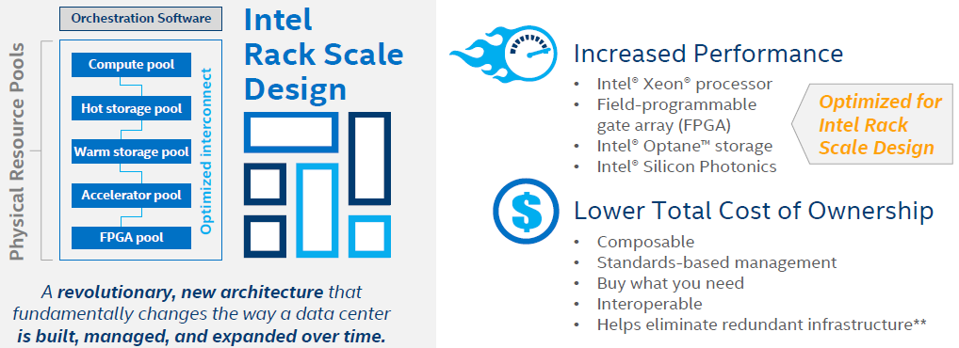
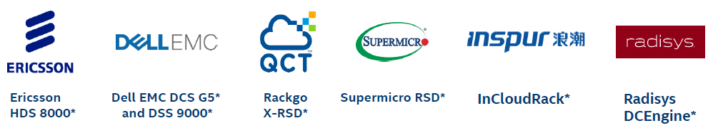
Intel RSD solution and partners

Slide 2
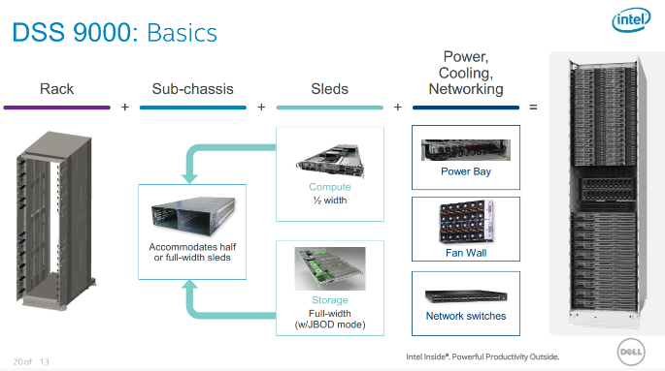
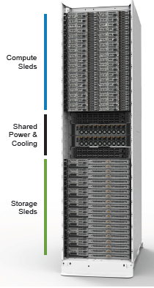
Dell EMC DSS 9000 (HW components)
Utility node: Dell EMC PowerEdge R430
TOR switch: Dell EMC S4048-ON switch
DSS: Datacenter Scalable Solutions
https://www.ithome.com.tw/review/110755

Slide 3
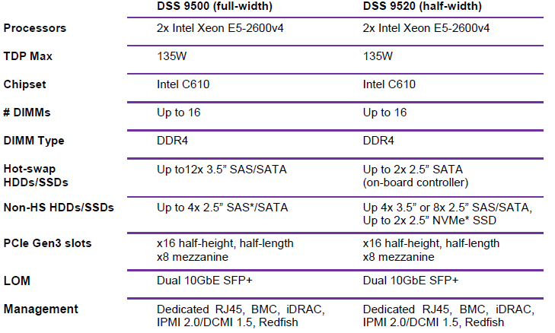
Dell EMC DSS 9000

Slide 4
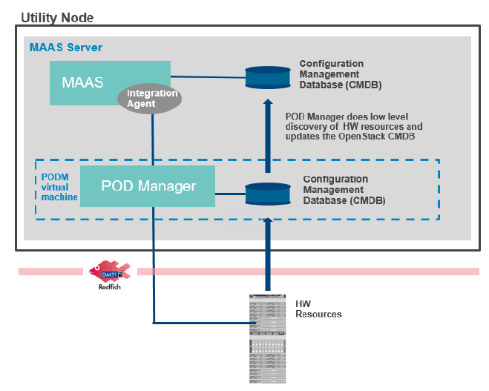
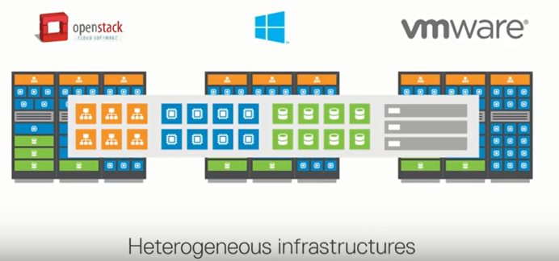
Dell EMC DSS 9000 (SW components)
Openstack Kickstart
  integration software that combines Intel Pod Manager and MAAS (Metal As A Service) to provide an easier and seamless “kickstart” for workload deployment
  Key components:
    a PODM virtual box VM
    PODM tools (to be installed on the utility node that drives deployment)
    kickstart integration software to run on the orchestration master node
    a customized bootstrap image for the orchestration tool to support the DSS 9000
    firmware/BIOS update tools (to apply firmware and BIOS configuration to multiple nodes)
OpenStack
Intel POD manager
Redfish
DSS 9000

Slide 5
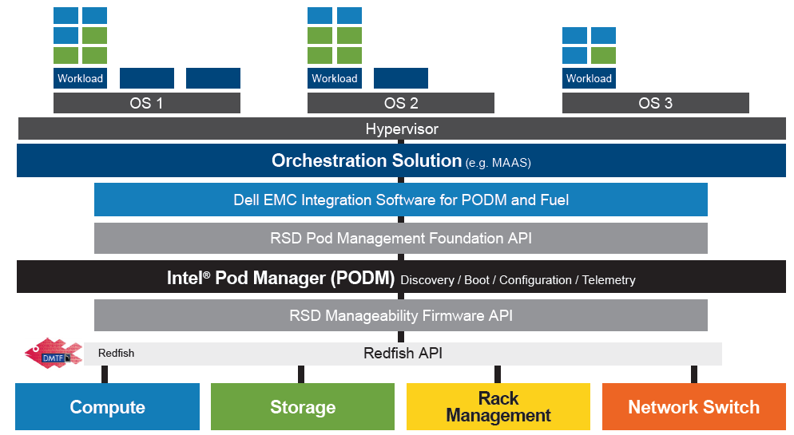
Dell EMC DSS 9000 with Intel RSD
Openstack Kickstart

Slide 6
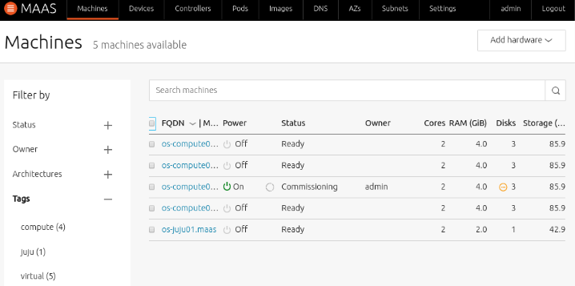
MASS
Web UI-driven interface for deployment and management of the OpenStack platform
https://docs.maas.io/2.5/en/intro-what-is-maas

Slide 7
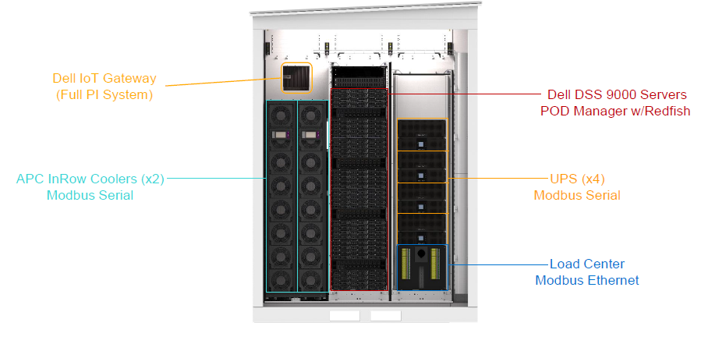
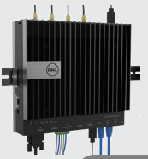
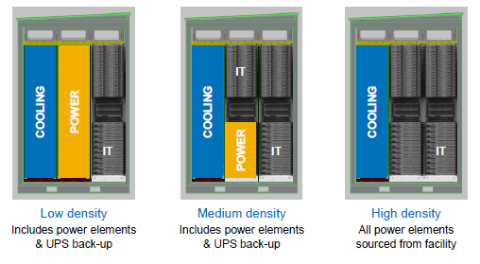
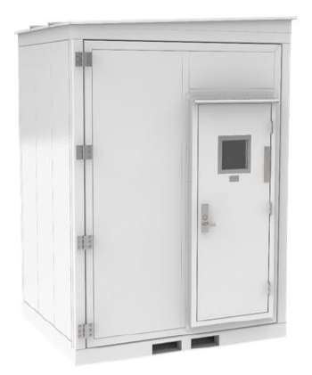
Dell EMC micro Modular Data Center
micro Modular Data Center (MDC) brings computational equipment closer to the edge network and reduces the amount of IoT data traveling to a centralized data center
DELL 5100 gateway
OSIsoft PI system

Slide 8
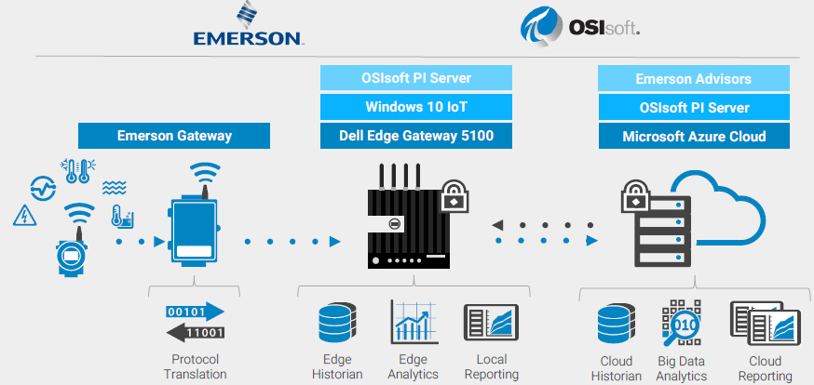
Dell Gateway 5100 with OSIsoft PI System

Slide 9
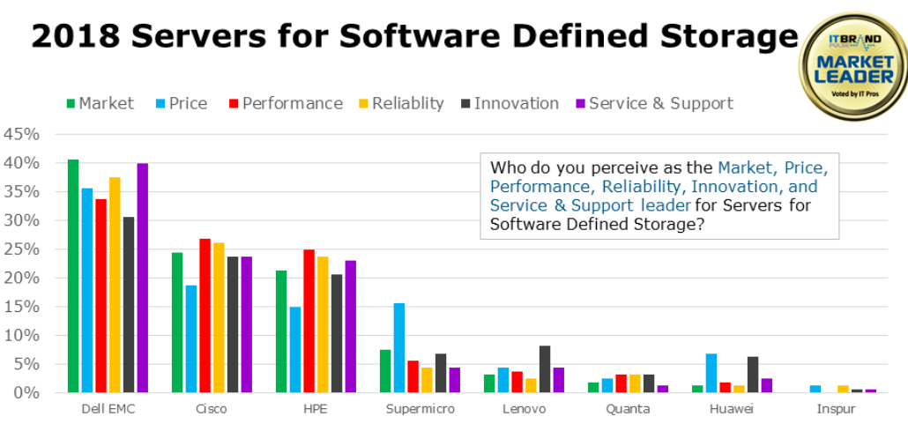
https://itbrandpulse.com/2018-sfsds-brand-leaders/

Slide 10
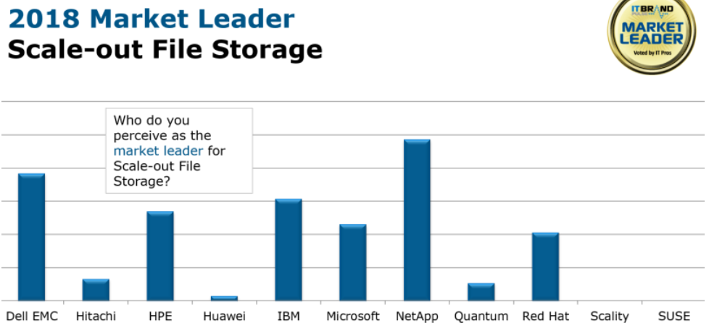
https://itbrandpulse.com/2018-sfsds-brand-leaders/

